Slide 1
Introduction to Cassandra
-Amey Manjrekar

Slide 2
What is NoSQL?
Non-relational databases use new and potentially unfamiliar architectures and data models, to satisfy the requirements of modern online applications, which generates low latency, unkon levels of scale data.These new databases must work on CAP theorem. They sacrifices traditional relational database features like automatic table joins and ACID transactions. In the majority of cases, these trade-offs are well worth it.

Slide 3
WHAT is CAP theorem?
CAP- Consistency Availability and Partition
No distributed system is safe from network failures, thus network partitioning generally has to be tolerated. In the presence of a partition, one is then left with two options: consistency or availability. When choosing consistency over availability, the system will return an error or a time-out if particular information cannot be guaranteed to be up to date due to network partitioning. When choosing availability over consistency, the system will always process the query and try to return the most recent available version of the information, even if it cannot guarantee it is up to date due to network partitioning.
When distributed system is running normally – both availability and consistency can be satisfied.

Slide 4
What is Apache Cassandra
Apache Cassandra is a massively scalable open source non-relational database that offers continuous availability, linear scale performance, operational simplicity and easy data distribution across multiple data centers and cloud availability zones. Cassandra was originally developed at Facebook, was open sourced in 2008, and became a top-level Apache project in 2010.

Slide 5
How Does Cassandra Differ From a Relational Database?
Relational Database | Cassandra
Handles moderate incoming data velocity | Handles high incoming data velocity
Data arriving from one/few locations | Data arriving from many locations
Manages primarily structured data | Manages all types of data
Supports complex/nested transactions | Supports simple transactions
Single points of failure with failover | No single points of failure; constant uptime
Supports moderate data volumes | Supports very high data volumes
Centralized deployments | Decentralized deployments
Data written in mostly one location | Data written in many locations
Supports read scalability (with consistency sacrifices) | Supports read and write scalability
Deployed in vertical scale up fashion | Deployed in horizontal scale out fashion

Slide 6
Key Cassandra Features and Benefits-1
Cassandra provides a number of key features and benefits for those looking to use it as the underlying database for modern online applications:
Massively scalable architecture – a masterless design where all nodes are the same, which provides operational simplicity and easy scale-out.
Active everywhere design – all nodes may be written to and read from.
Linear scale performance – the ability to add nodes without going down produces predictable increases in performance.
Continuous availability – offers redundancy of both data and node function, which eliminate single points of failure and provide constant uptime.
Transparent fault detection and recovery – nodes that fail can easily be restored or replaced.

Slide 7
Key Cassandra Features and Benefits-2
Flexible and dynamic data model – supports modern data types with fast writes and reads.
Strong data protection – a commit log design ensures no data loss and built in security with backup/restore keeps data protected and safe.
Tunable data consistency – support for strong or eventual data consistency across a widely distributed cluster.
Multi-data center replication – cross data center (in multiple geographies) and multi-cloud availability zone support for writes/reads.
Data compression – data compressed up to 80% without performance overhead.
CQL (Cassandra Query Language) – an SQL-like language that makes moving from a relational database very easy.

Slide 8

Architecture Overview
Cassandra’s architecture is responsible for its ability to scale, perform, and offer continuous uptime. Rather than using a legacy master-slave or a manual and difficult-to-maintain sharded design, Cassandra has a masterless “ring” architecture that is elegant, easy to set up, and easy to maintain.
In Cassandra, all nodes play an identical role; there is no concept of a master node, with all nodes communicating with each other via a distributed, scalable protocol called "gossip."
To add more capacity, you simply add new nodes to an existing cluster without having to take it down first.

Slide 9
Cassandra Data Objects
The basic objects you will use in Cassandra include:
Keyspace – a container for data tables and indexes; analogous to a database in many relational databases. It is also the level at which replication is defined.
Table – somewhat like a relational table, but capable of holding vastly large volumes of data. A table is also able to provide very fast row inserts and column level reads.
Primary key – used to identity a row uniquely in a table and also distribute a table’s rows across multiple nodes in a cluster.
Index – similar to a relational index in that it speeds some read operations; also different from relational indices in important ways.

Slide 10
Writing Data in cassandra
Cassandra is well known for its impressive performance in both reading and writing data.
Data is written to Cassandra in a way that provides both full data durability and high performance. Data written to a Cassandra node is first recorded in an on-disk commit log and then written to a memory-based structure called a memtable. When a memtable’s size exceeds a configurable threshold, the data is written to an immutable file on disk called an SSTable. Buffering writes in memory in this way allows writes always to be a fully sequential operation, with many megabytes of disk I/O happening at the same time, rather than one at a time over a long period.
Many SSTables can exist for a single Cassandra logical data table. Compaction occurs on a periodic basis, coalescesing multiple SSTables into one for faster read access.

Slide 11
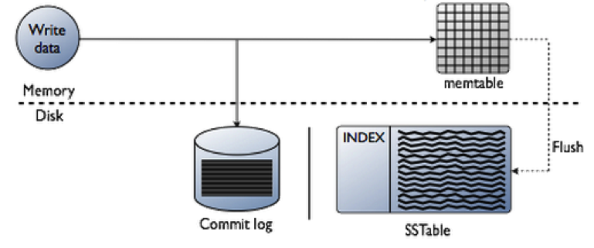
Writing Data in cassandra

Slide 12
Reading Data FROM cassandra
For a read request, Cassandra consults an in-memory data structure called a Bloom filter that checks the probability of an SSTable having the needed data. The Bloom filter can tell very quickly whether the file probably has the needed data, or certainly does not have it. If answer is a tenative yes, Cassandra consults another layer of in-memory caches, then fetches the compressed data on disk. If the answer is no, Cassandra doesn’t trouble with reading that SSTable at all, and moves on to the next.

Slide 13
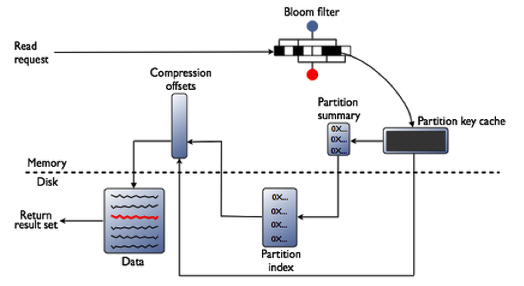
Reading Data FROM cassandra

Slide 14
Data Distribution and Replication
Cassandra has an internal component called a partitioner. A partitioner is a hashing mechanism that takes a table row’s primary key, computes a numerical token for it, and then assigns it to one of the nodes in a cluster in a way that is predictable and consistent.
Partitioner is one that randomizes data across a cluster and ensures an even distribution of all data. Cassandra also automatically maintains the balance of data across a cluster even when existing nodes are removed or new nodes are added to a system.
A Cassandra cluster can have one or more keyspaces. Replication is configured at the keyspace level, allowing different keyspaces to have different replication models.
Once a keyspace and its replication have been created, Cassandra automatically maintains that replication even when nodes are removed, added, or fail.

Slide 15
Transaction Management
While Cassandra does not support ACID transactions like most legacy relational databases, it does offer the “AID” portion of ACID.
Writes to Cassandra are atomic, isolated, and durable. The “C” of ACID—​consistency—​does not apply to Cassandra, as there is no concept of referential integrity or foreign keys.

Slide 16
Ensuring Data Consistency
There are occasions when data inconsistencies occur in a cluster due to incidents like nodes becoming unavailable or disruptions in network connectivity. Cassandra takes steps automatically to reduce the impact of cluster "entropy" of this kind, but administrators must also periodically run maintenance operations to ensure that data is consistent across all nodes in the cluster.
Cassandra provides a scriptable operation called repair that you can run as needed to ensure that all nodes are consistent with respect to the data they contain.

